Slide 1
BIT 353 ARTIFICIAL INTELLIGENCE
Lecturer: Saroj Poudel
Qualification: MS CIS&IT
Profession: Senior Software Developer/CTO
Lincoln University College, CN 1221

Slide 2


Knowledge, Reasoning and Planning
In this chapter we will learn about:
Knowledge based agents
Proportional logic
First order logic
Forward Chaining
Backward Chaining

Slide 3
Knowledge Based agents
Knowledge-based agents use a process of reasoning over an internal representation of knowledge to decide what actions to take.
The central component of a knowledge-based agent is its knowledge base, or KB.
A knowledge base is a set of sentences.
Each sentence is expressed in a language called a knowledge representation language and represents some assertion about the world.
A KB can initially contain some background information about the world, and a knowledge-based agent can add to the information in the KB through its observations of the world.

Slide 4
Knowledge based agents
There are two kinds of sentences:
Axiom: a sentence that is taken as being given and not derived from other sentences
Derived: a new sentence that is derived from others sentences.
There must be a way to add new sentences to the knowledge base and a way to query what is known. The standard names for these operations are TELL and ASK, respectively.
The process of deriving new sentences from old sentences is called inference.

Slide 5
Natural Language Sentences | Knowledge Representation Sentences
Venus is a planet | Planet(venus)
Venus is unhabitable | Unhabitable(venus)
Venus is near its sun | near(venus, sun)
If a planet is near its sun, then it is hot | Planet(x) and sun(y) and near(x,y) -> hot(x)

Slide 6

Hunt the Wumpus

Slide 7

Wumpus world
Our knowledge-based agent, Shankar, explores a cave consisting of rooms connected by passageways.
Lurking somewhere in the cave is the Wumpus, a beast that eats any agent that enters its room.
Some rooms contain bottomless pits that trap any agent that wanders into the room. In one room is master Luke.
The goal is:
collect Luke
exit the world
without being eaten
Hello

Slide 8
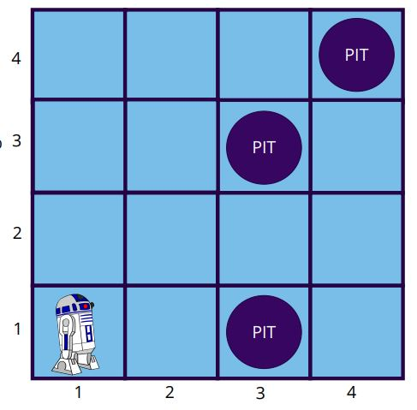
Wumpus World
Environment: A 4x4 grid of rooms. The agent starts in the square [1,1]. Wumpus and Luke are randomly placed in other squares. Each square can be pit with 20% probability.

Slide 9
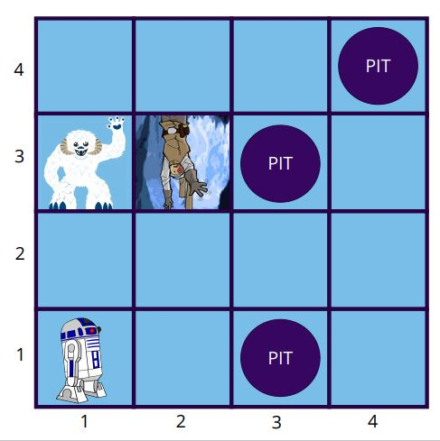
Wumpus World
Performance measure:
+1000 points for rescuing Luke and leaving the cave
-1000 for falling into a pit or being eaten by the Wumpus
-1 for each action taken
-10 for using up your blaster fire

Slide 10
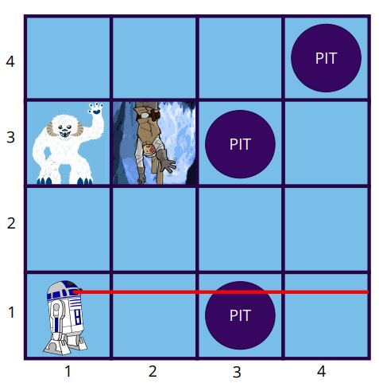
Wumpus World
Actuators:
Shankar can move Forward, TurnLeft, Turn right.
Agent dies if it moves into a pit or a Wumpus square.
Grab can pick up Luke.
Shoot fires blaster bolt in a straight line in the direction that Shankar is facing.
If the blaster hits the Wampa, it dies.
Shankar only has enough power for one shot.
Climb gets Shankar out of the cave but only works in [1, 1]

Slide 11
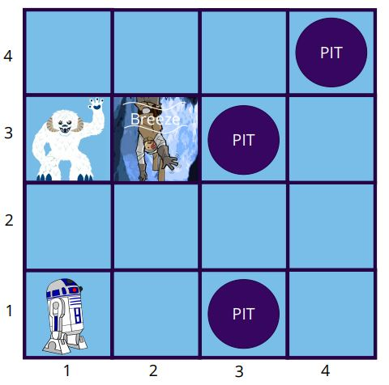
Wumpus World
Sensors
In each square adjacent to the Wampa, Shankar olfactory sensor perceives a Stench
In each square adjacent to a pit, Shankar’s wind sensor perceives a Breeze
In the square with Luke, Shankar’s audio
sensor perceives a Gasp
When Shankar walks into a wall it perceives a Bump
When the Wampa is killed , Shankar’s audio sensor perceives a Scream
Percept=[Stench, Breeze, None, None, None]

Slide 12
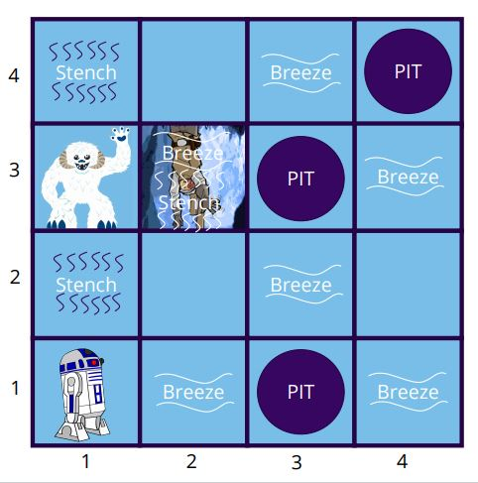
Wumpus World
Deterministic, discrete, static, single- agent (Wampa doesn’t move)
Sequential because reward doesn’t come for many steps
Partially observable because some parts
of the state are not directly perceivable:
- Location of Luke, Wampa, and pits aren’t directly observable.

Slide 13
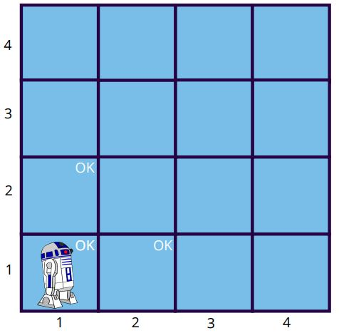
Wumpus World
Shankar starts in [1,1]
Percept=[None, None, None, None, None]
What can we conclude about [1,2] and [2,1]?

Slide 14
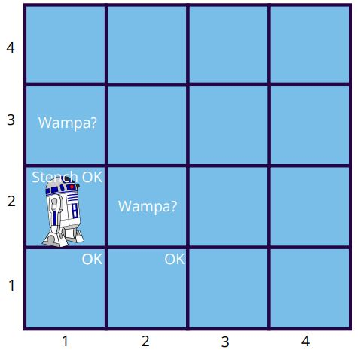
Wumpus World
Shankar moves to [1,2]
Percept=[Stench, None, None, None None]
What can we conclude about [3,1] and [2,2] from the Stench?

Slide 15
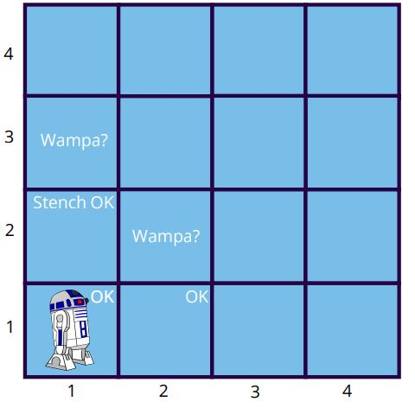
Wumpus World
Shankar moves back to [1,1] and gets the same percept vector as before
Percept=[None, None, None, None None]

Slide 16
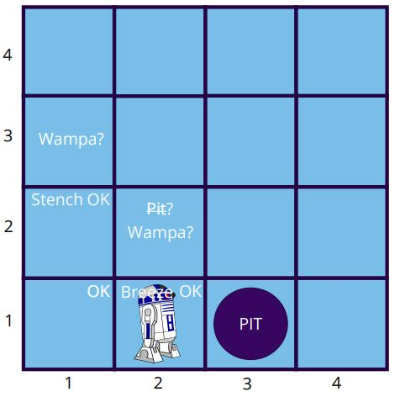
Wumpus World
Shankar moves to [2,1]
Percept=[None, Breeze, None, None None]
What can we conclude about [3,1] and [2,2] based on the Breeze?

Slide 17
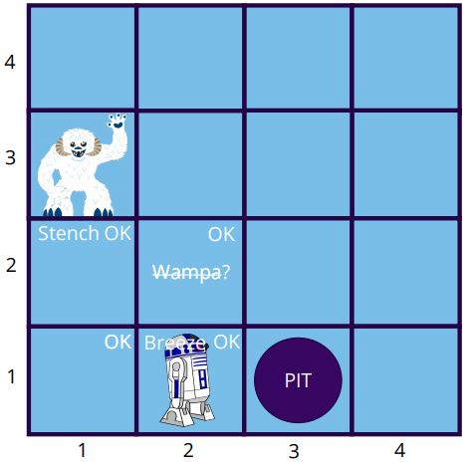
Wumpus World
Shankar moves to [2,1]
Percept=[None, Breeze, None, None None]
What can we conclude about [2,2] and [1,3] based on the lack of a Stench here?

Slide 18
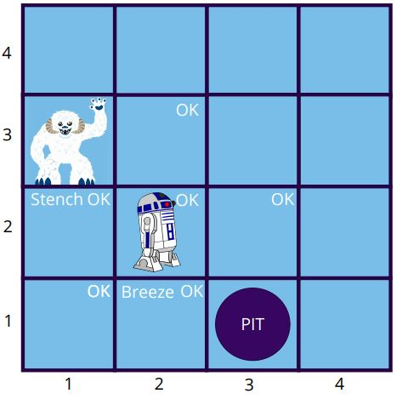
Wumpus World
Shankar moves to [2,2]
Percept=[None, None, None, None, None]

Slide 19
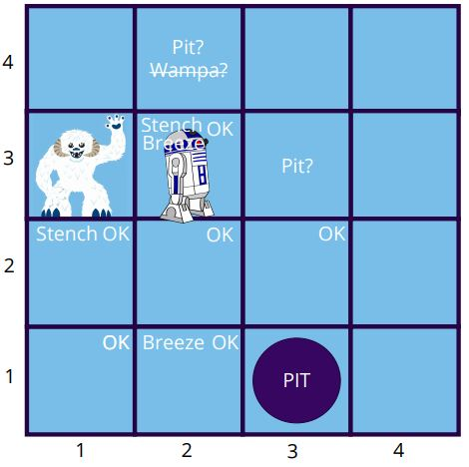
Wumpus World
Shankar moves to [2,3]
Percept=[Stench, Breeze, Gasp, None, None]
What can we conclude about [2,4] or [3,3]?

Slide 20
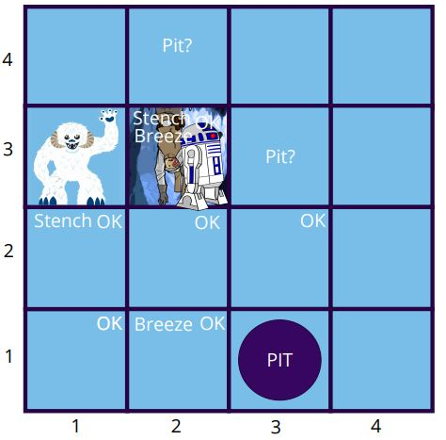
Shankar moves to [2,3]
Percept=[Stench, Breeze, Gasp, None, None]
We heard a Gasp, so Luke is here!

Slide 21
Logic
Logic can serve as a general class of representations for knowledge-based agents. Here we are going to examine Propositional Logic.
KB consists of sentences in the representation language
Representation language has a syntax that specifies sentences that are well-formed
A logic defines the semantics of the sentences, which is their meaning
The semantics defines the truth of each sentence with respect to a possible world, which we will often call a model.

Slide 22
Logic
For example, the semantics for arithmetic specifies that the sentence “ x+y=4” is true in a world where x is 2 and y is 2, but false in a world where x is 1 and y is 1.
In standard logics, every sentence must be either true or false in each possible world—there is no “in between.”
When we need to be precise, we use the term model in place of “possible world.”

Slide 23
Logic
If sentence 𝛂 is true in model m then we say
m satisfies 𝛂, or
m is a model of 𝛂
We use the notation M(𝛂) to mean the set of all models of 𝛂.

Slide 24
Logical Entailment
Once we have a notion of truth, we can start to define logical reasoning. Logical reasoning involves the entailment relation between sentence.
In plain English, entailment is the idea that a sentence follows logically from another sentence.
To write sentence 𝛂 entails sentence β in mathematical notation we use the ⊨ symbol:
𝛂⊨β
The definition is
𝛂⊨β if and only if M(𝛂) ⊆ M(β)(model of alpha is subset of model of beta)
This means that 𝛂 is more specific, or stronger than, β. For instances, β could mean that “The agent is a robot” and 𝛂 could mean “The agent is an astromech”.

Slide 25
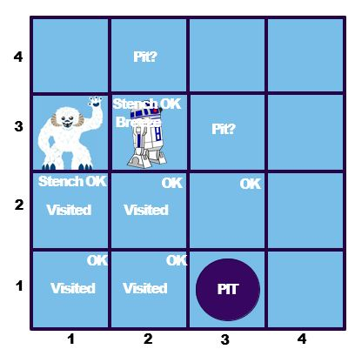
Knowledge Base
The KB can be thought of as a set of sentences.
𝛂₁ = “There is no pit in [1,2]”
𝛂₂ = “There is a pit in [3,1]”
𝛂₃ = “There is a wampa in [1,3]”
The KB is false in models that contradict what the agent knows. For example, the KB is false in any model m where [1,2] contains a pit.
Possible Worlds is the process of enumerating all Possible Worlds that are compatible with the KB. M(KB) ⊆ M(𝛂₁ )

Slide 26
Logical inference
Entailment can be applied to derive conclusions, which is the process of logical inference.
We can think about the consequences of a KB as a large set of additional sentences that are entailed given the sentences that have been added to the KB.
We would like to design inference algorithms to enumerate these sentences. When an inference algorithm i allows us to conclude that 𝛂 is true, then we write
KB ⊢_{i} 𝛂
“𝛂 is derived from KB by i”

Slide 27
Propositional logic
Propositional logic (PL) is the simplest form of logic where all the statements are made by propositions.
A proposition is a declarative statement which is either true or false.
Example
The Sun rises from West (False proposition)
5 is a prime number (True proposition)
Propositional logic is also called Boolean logic as it works on 0 and 1.
Propositions can be either true or false, but it cannot be both.

Slide 28
Types of Proposition
There are basically two types of proposition.
Atomic Proposition
Compound Proposition
Atomic propositions are the simple propositions. It consists of a single proposition symbol.
Example a) 2+2 is 4, it is an atomic proposition as it is a true fact.
b) "The Sun is cold" is also a proposition as it is a false fact.

Slide 29
Types of Proposition
Compound proposition:
Compound propositions are constructed by combining simpler or atomic propositions, using parenthesis and logical connectives.
Example
"It is raining today, and street is wet."
“Ram is a software engineer, and he works in Kathmandu."

Slide 30
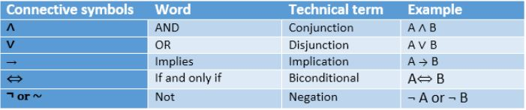
Logical Connectives
Logical connectives are used to connect two simpler propositions or representing a sentence logically.
We can create compound propositions with the help of logical connectives.
There are mainly five connectives, which are given as follows:

Slide 31
Logical Connectives
Negation: A sentence such as ¬ P is called negation of P. A literal can be either Positive literal or negative literal.
Conjunction: A sentence which has ∧ connective such as, P ∧ Q is called a conjunction.
Example: Rajesh is intelligent and hardworking. It can be written as,
P= Rajesh is intelligent,
Q= Rajesh is hardworking. → P∧ Q.
3. Disjunction: A sentence which has ∨ connective, such as P ∨ Q. is called disjunction, where P and Q are the propositions.
Example: “Rita is a doctor or Engineer",
Here P= Rita is Doctor. Q= Rita is an Engineer, so we can write it as P ∨ Q.

Slide 32
Logical Connectives Continued
4. Implication: A sentence such as P → Q, is called an implication. Implications are also known as if-then rules. It can be represented as
If it is raining, then the street is wet.
Let P= It is raining, and Q= Street is wet, so it is represented as P → Q
5. Biconditional: A sentence such as P⇔ Q is a Biconditional sentence, example If I am breathing, then only I am alive.
P= I am breathing, Q= I am alive, it can be represented as P ⇔ Q.
Operator Precedence: ¬, ∧ , ∨, →, ⇔

Slide 33
Logical Connectives continued
For complex sentences, we have five rules which hold for any subsentences P and Q in any model m. Here iff means if and only if.
¬ P is true iff P is false in m.
P ∧ Q is true iff both P and Q are true in m.
P ∨ Q is true iff either P or Q is true in m.
P → Q is true unless P is true and Q is false in model m.
P⇔ Q is true iff P and Q are both true or both false in model m.

Slide 34
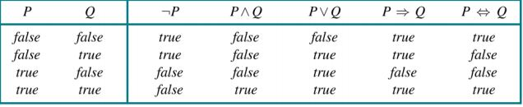
Truth table
The above rules can be represented in a truth table.

Slide 35
Limitation of Propositional Logic
We cannot represent relations like ALL, some, or none with propositional logic. Example
All the girls are intelligent.
Some apples are sweet.
Propositional logic has limited expressive power.

Slide 36
First Order Logic
It is an extension to propositional logic.
FOL is sufficiently expressive to represent the natural language statements in a concise way.
First-order logic is also known as Predicate logic or First-order predicate logic.
Important elements in natural language:
Objects (squares, pits, wumpuses)
Relations among objects (is adjacent to, is bigger than) or unary relations or properties (is red, round)
Functions (father of, best friend of)
First-order logic (FOL) is built around the above 3elements

Slide 37
Syntax of FOL
Basic symbols: objects (constant symbols), relations
(predicate symbols), and functions (functional symbols).
Constants King John, 2, Wumpus...
Predicates Brother, >,...
Functions Sqrt, LeftLegOf,...
Variables x, y, a, b,...
Connectives ∧, ∨, ¬, ⇒, ⇔
Equality =
Quantifiers ∀, ∃
A legitimate expression of predicate calculus is called wellformed formula (wff), or simply, sentence.

Slide 38
Atomic and Composite Sentences
Atomic Sentences:
Atomic sentences are the most basic sentences of first-order logic.
These sentences are formed from a predicate symbol followed by a parenthesis with a sequence of terms.
We can represent atomic sentences as Predicate (term1, term2, ......, term n)
Example: Ravi and Ajay are brothers: => Brothers(Ravi, Ajay).
Lyka is a dog: => dog (Lyka).
Complex Sentences:
Complex sentences are made by combining atomic sentences using connectives.

Slide 39
First-order logic statements can be divided into two parts:
Subject: Subject is the main part of the statement.
Predicate: A predicate can be defined as a relation, which binds two atoms together in a statement.
Consider the statement: "x is an integer.", it consists of two parts, the first part x is the subject of the statement and second part "is an integer," is known as a predicate.

Slide 40
Quantifiers in FOL
A quantifier is a language element which generates quantification, and quantification specifies the quantity of specimen in the universe of discourse.
These are the symbols that permit to determine or identify the range and scope of the variable in the logical expression.
There are two types of quantifier:
Universal Quantifier, (for all, everyone, everything)
Existential quantifier, (for some, at least one).

Slide 41
Universal Quantifier
Universal quantifier is a symbol of logical representation, which specifies that the statement within its range is true for everything or every instance of a particular thing.
The Universal quantifier is represented by a symbol ∀, which resembles an inverted A.
In universal quantifier we use implication "→“.
If x is a variable, then ∀x is read as:
For all X
For each x
For every x.
Example: “All man drink coffee” can be written as ∀x: man(x) → drink (x, coffee).
It will be read as: There are all x where x is a man who drink coffee.

Slide 42
Existential Quantifier
Existential quantifiers are the type of quantifiers, which express that the statement within its scope is true for at least one instance of something.
It is denoted by the logical operator ∃, which resembles as inverted E. When it is used with a predicate variable then it is called as an existential quantifier.
In Existential quantifier we always use AND or Conjunction symbol (∧).
If x is a variable, then existential quantifier will be ∃x or ∃(x). And it will be read as:
There exists a 'x.’
For some 'x.’
For at least one 'x.’
Example: “Some boys are intelligent” can be written as ∃x: boys(x) ∧ intelligent(x).
It will be read as: There are some x where x is a boy who is intelligent.

Slide 43
Properties of Quantifier
In universal quantifier, ∀x∀y is similar to ∀y∀x.
In Existential quantifier, ∃x∃y is similar to ∃y∃x.
∃x∀y is not similar to ∀y∃x.

Slide 44
Example of FOL quantifier
1. All birds fly.
In this question the predicate is "fly(bird)."
And since there are all birds who fly so it will be represented as follows.
∀x: bird(x) →fly(x).
2. Every man respects his parent.
In this question, the predicate is "respect(x, parent)," where x=man
Since there is every man so will use ∀, and it will be represented as follows:
∀x: man(x) → respects (x, parent).

Slide 45
3. Some boys play cricket.
In this question, the predicate is "play(x, cricket)," where x= boys. Since there are some boys so we will use ∃, and it will be represented as:
∃x boys(x) ^ play(x, cricket).
4. Not all students like both Mathematics and Science.
In this question, the predicate is "like(x, y)," where x= student, and y= subject.
Since there are not all students, so we will use ∀ with negation, so following representation for this:
¬(∀ (x) [ student(x) → like(x, Mathematics) ∧ like(x, Science)]).

Slide 46
Your turn to convert to FOL
Lucy is a professor
All professors are people.
John is the dean.
Deans are professors.
All professors consider the dean a friend or don’t know him.
Everyone is a friend of someone.

Slide 47
Answers
is-prof(lucy)
∀x ( is-prof(x) → is-person(x) )
is-dean(John)
∀x (is-dean(x) → is-prof(x))
∀x (∀y ( is-prof(x) ∧ is-dean(y) → friend(y,x) ∨ ¬ knows(x, y) ) )
∀ x (∃ y ( is-friend-of (y, x) ) )
∀ ∃ ∧, ∨, ¬, ⇒, ⇔

Slide 48
Equality in FOL
In FOL, we can use equality symbols which specify that the two terms refer to the same object.
Example: Brother (John) = Smith.
In the above example, the object referred by the Brother (John) is similar to the object referred by Smith.
The equality symbol can also be used with negation to represent that two terms are not the same objects.
Example: ￢(x=y) which is equivalent to x ≠y.

Slide 49
Substitution in FOL
Substitution is a fundamental operation performed on terms and formulas.
It occurs in all inference systems in first-order logic.
If we write F[a/x], so it refers to substitute a constant "a" in place of variable "x".

Slide 50
Inference in First Order Logic
Inference in First-Order Logic is used to deduce new facts or sentences from existing sentences.
We will be discussing two basic rules for inference in FOL:
Universal Instantiation
Existential Instantiation

Slide 51
Universal Instantiation
Universal instantiation is also called as universal elimination.
It can be applied multiple times to add new sentences.
The new KB is logically equivalent to the previous KB.
The rule of Universal Instantiation (UI for short) says that we can infer any sentence obtained by substituting a ground term (a term without variables) for a universally quantified variable.
It can be represented as ∀v α
SUBST({v/g},α)
For any variable ‘v’ and ground term ‘g’ within a sentence ‘α’.

Slide 52
UI examples
IF "Every person like ice-cream"=> ∀x P(x) so we can infer that
"John likes ice-cream" => P(c)
Another famous example
"All kings who are greedy are Evil." So let our knowledge base contains this detail as in the form of FOL:
∀x king(x) ∧ greedy (x) → Evil (x)
So, from this information, we can infer any of the following statements using Universal Instantiation:
King(John) ∧ Greedy (John) → Evil (John),
King(Richard) ∧ Greedy (Richard) → Evil (Richard),
King(Father(John)) ∧ Greedy (Father(John)) → Evil (Father(John)),

Slide 53
Existential Instantiation
Existential instantiation is also called as Existential Elimination.
It can be applied only once to replace the existential sentence.
The new KB is not logically equivalent to old KB, but it will be satisfiable if old KB was satisfiable.
The rule of Existential Instantiation replaces an existentially quantified variable with a single new constant symbol.
The formal statement is as follows: for any sentence α ,variable v, and constant k symbol that does not appear elsewhere in the knowledge base.
∃v α
SUBST({v/k},α)`

Slide 54
Example OF EI
From the given sentence: ∃x Crown(x) ∧ OnHead(x, John),
We can infer: Crown(K) ∧ OnHead( K, John), as long as K does not appear in the knowledge base.
The above used K is a constant symbol, which is called Skolem constant.
The Existential instantiation is a special case of Skolemization process.

Slide 55

Generalized Modus Ponens rule
For the inference process in FOL, we have a single inference rule which is called Generalized Modus Ponens.
For atomic sentences pi, pi', q. Where there is a substitution θ such that SUBST (θ, pi',) = SUBST(θ, pi), it can be represented as:
Example:
We will use this rule for Kings are evil, so we will find some x such that x is king, and x is greedy so we can infer that x is evil.
Here let say, p1' is king(John) p1 is king(x)
p2' is Greedy(y) p2 is Greedy(x)
θ is {x/John, y/John} q is evil(x)
SUBST(θ,q) is Evil(John)

Slide 56
p1 ′ is King(John) p1 is King(x)
p2 ′ is Greedy(y) p2 is Greedy(x)
θ is {x/John,y/John} q is Evil(x)
SUBST(θ,q) is Evil(John).

Slide 57
Inference Engine
The inference engine is the component of the intelligent system in artificial intelligence, which applies logical rules to the knowledge base to infer new information from known facts.
Inference engine commonly proceeds in two modes, which are:
Forward chaining
Backward chaining
Horn Clause: A clause which is a disjunction of literals with at most one positive literal.
Definite Clause: A clause which is a disjunction of literals with exactly one positive literal
Example: (¬ p V ¬ q V k). It has only one positive literal k.

Slide 58
Forward Chaining
Also known as a forward deduction or forward reasoning method when using an inference engine.
Form of reasoning which start with atomic sentences in the knowledge base and applies inference rules (Modus Ponens) in the forward direction to extract more data until a goal is reached.
It starts from known facts, triggers all rules whose premises are satisfied, and add their conclusion to the known facts. This process repeats until the problem is solved.

Slide 59
Properties of Forward Chaining
It is a bottom-up approach, as it moves from bottom to top.
It is a process of making a conclusion based on known facts or data, by starting from the initial state and reaches the goal state.
Forward-chaining approach is also called as data-driven as we reach to the goal using available data.
Forward -chaining approach is commonly used in the expert system, such as CLIPS, business, and production rule systems.

Slide 60
Example
“The law says that it is a crime for an American to sell weapons to hostile nations. The country “A”, an enemy of America, has some missiles, and all of its missiles were sold to it by Robert, who is American.”
Let us first represent these sentences in FOL:
American(p) ∧ Weapon(q) ∧ Sells(p,q,r) ∧ Hostile(r) ⇒ Criminal(p).
Owns(A,T1)
Missile(T1).
Missile(x) ∧ Owns(A,x) ⇒ Sells(Robert,x,A).
Missile(x) ⇒ Weapon(x)
Enemy(x,America) ⇒ Hostile(x).
American(Robert)
Enemy(A,America).

Slide 61
Proof
Step 1:
In the first step we will start with the known facts and will choose the sentences which do not have implications, such as: American(Robert), Enemy(A, America), Owns(A, T1), and Missile(T1). All these facts will be represented as below.

Slide 62
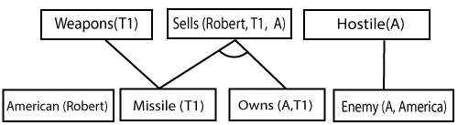
Step 2:
At the second step, we will see those facts which infer from available facts and with satisfied premises.
Rule-(1) does not satisfy premises, so it will not be added in the first iteration.
Rule-(2) and (3) are already added.
Rule-(4) satisfy with the substitution {p/T1}, so Sells (Robert, T1, A) is added, which infers from the conjunction of Rule (2) and (3).
Rule-(6) is satisfied with the substitution(p/A), so Hostile(A) is added and which infers from Rule-(7).

Slide 63
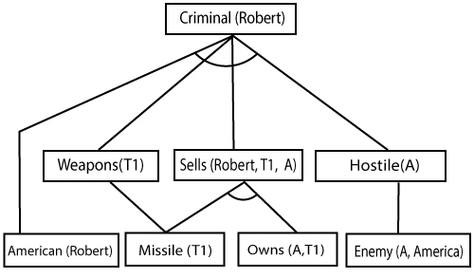
Proof of forward chaining
At step-3, as we can check Rule-(1) is satisfied with the substitution {p/Robert, q/T1, r/A}, so we can add Criminal(Robert) which infers all the available facts. And hence we reached our goal statement.

Slide 64
Backward chaining
Backward-chaining is also known as a backward deduction or backward reasoning method when using an inference engine.
A backward chaining algorithm is a form of reasoning.
It starts with the goal and works backward, chaining through rules to find known facts that support the goal.

Slide 65
Properties of Backward Chaining
It is known as a top-down approach.
In backward chaining, the goal is broken into sub-goal or sub-goals to prove the facts true.
It is called a goal-driven approach, as a list of goals decides which rules are selected and used.
Backward -chaining algorithm is used in game theory, automated theorem proving tools, inference engines, proof assistants, and various AI applications.

Slide 66
Thank you

